Slide 1
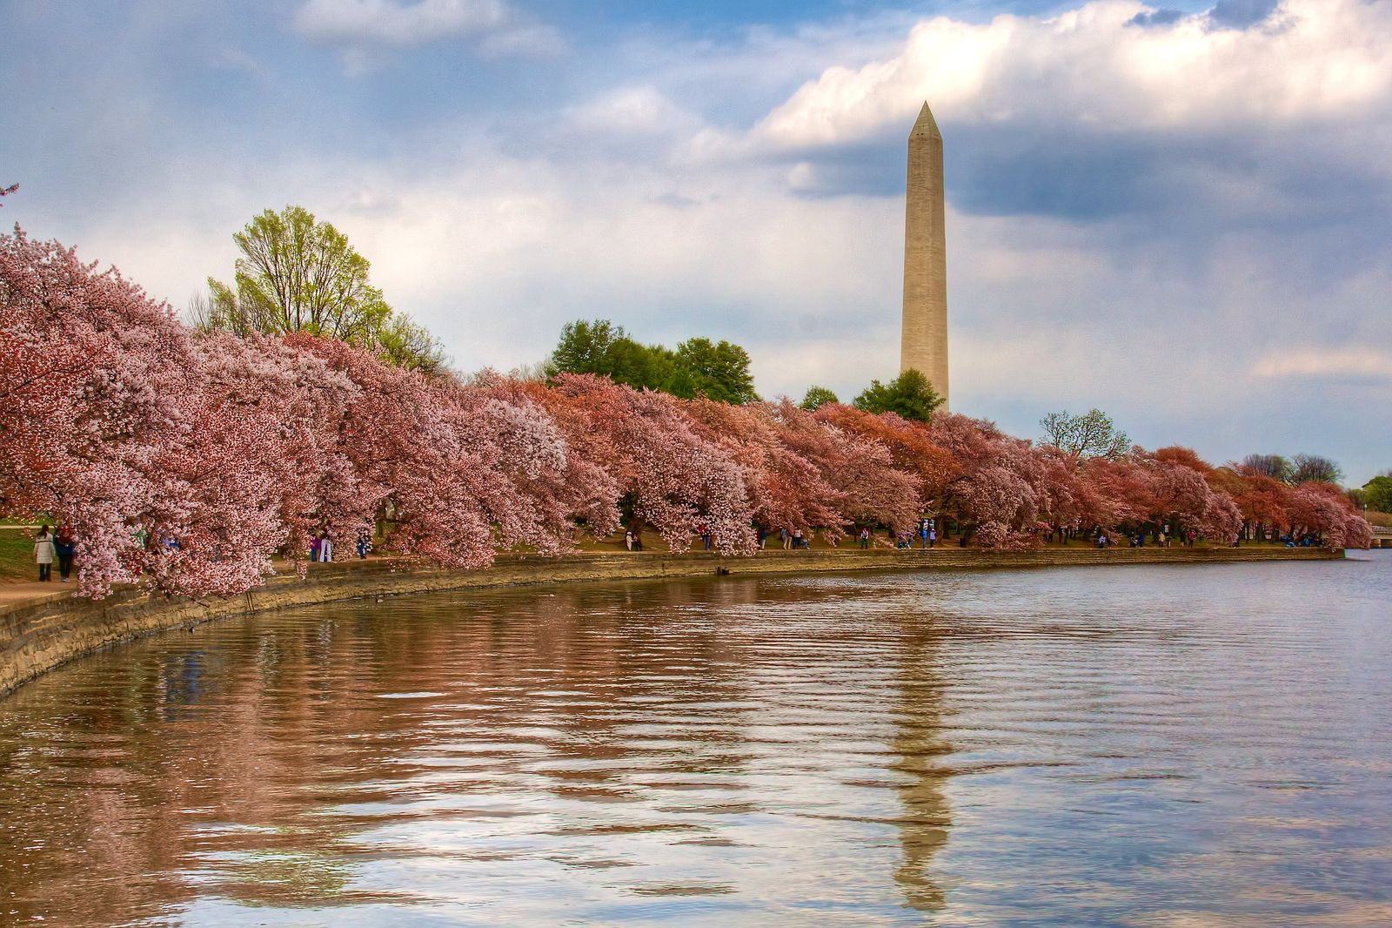
Landover Hills Community Engagement Survey
Josh Choi, Jack Miller, Persephone Moran, Emerald San

Slide 2
Team Members’ Roles:
Project Manager: Josh Choi
Data Analyst and Programmer: Persephone Moran
UX and Survey Designer: Jack Miller
Project Client Communication Lead & Project Quality Assurance Tester: Emerald San

Slide 3

Our Client - The Town of Landover Hills
Seeks to enhance resident participation in local government and community activities.
To do this, we need to understand residents’ interests, priorities, and preferred methods of engagement.

Slide 4
Goals & Objectives
Collect Community Engagement Data
Develop a community engagement survey to gather resident feedback
Address bias and barriers to survey participation
Distribute survey through multiple platforms to ensure accessibility
Refine Community Outreach Strategies
Use past and current survey data to identify what works and what needs to be changed
Analyze data to develop strategy for town officials
Inform Decision-Making
Present project deliverables, giving actionable insights to town officials
Recommend and discuss strategies for improving community engagement

Slide 5
Project Scope
A Requirements Document confirming the project needs, technical requirements, and non-technical requirements.
A Survey designed and developed to assess resident interest in community engagement. This survey will involve:
Identifying key areas of interest for community involvement, including potential committees and initiatives.
Determining the most pressing issues in the community that could benefit from increased resident participation.
Gathering input on preferred levels of engagement, time commitments, and communication methods.
Researching best practices for community surveys to maximize response rates and actionable insights.
Final presentation to the client and other stakeholders.
Final report on project outcomes, inclusive of any recommendations.

Slide 6
Final Project Deliverables
Survey Design Document - A detailed plan outlining the survey objectives, key questions, and methodology.
Draft Survey - A resident-friendly survey designed to gather meaningful insights on community engagement preferences.
Survey Distribution Plan - Recommendations on how to effectively distribute the survey to residents.
Engagement Strategy Report - A summary of best practices for increasing resident participation and sustaining engagement.
Final Presentation & Report - A report and presentation to town officials summarizing survey content, distribution recommendations, visualizing data, and proposed strategies for ongoing community involvement.

Slide 7
Technical Requirements
Google Forms survey
Social media survey distribution (Facebook, Instagram, Twitter)
Email list and town newsletter survey distribution
Data analysis using Excel and Python
Data visualizations using Excel and Python

Slide 8
Project Progress
Behind schedule. Our client never provided us the main data source we were looking for.
Analyze previous survey data
Develop draft survey and obtain feedback from the client
Develop survey distribution plan
Create survey design document
Create engagement strategy report

Slide 9
Project Challenges
Communication; and data access.
Client takes a bit of time to respond back to emails
Client said he would provide access to relevant organizational materials.
We asked for previous survey attempts to look at how clients responded to other communication methods, or suggestions on time commitments, preferred levels of engagement, etc.,
So far he has only provided with one survey with a spreadsheet of responses, but unfortunately did not give access to view the data received so we cannot go too in depth with it.
So based on the survey received we will draft a survey.

Slide 10
Questions?

